Slide 1
Thomas Bittner and Barry Smith
IFOMIS (Saarbrücken)
Normalizing Medical Ontologies Using Basic Formal Ontology

Slide 2
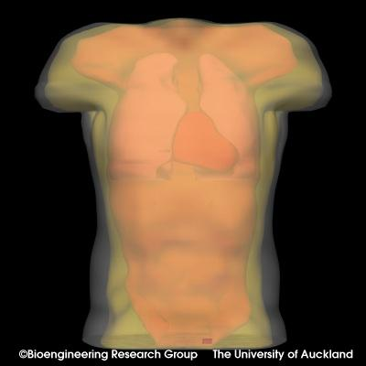
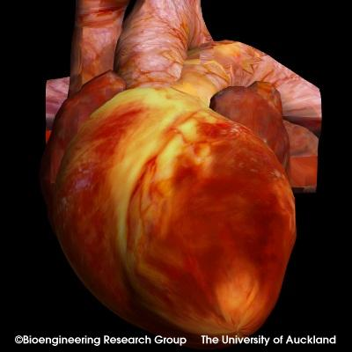
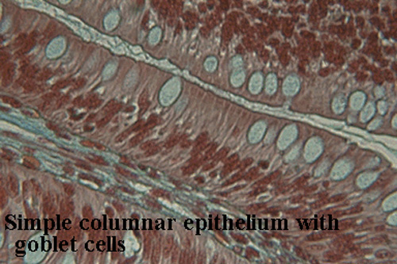
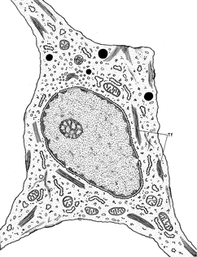
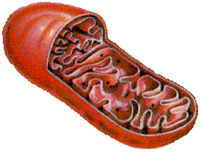
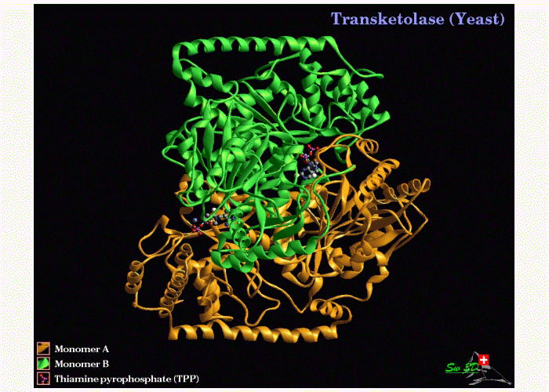
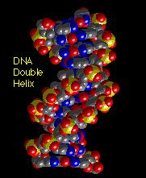
Scales of anatomy
Organism
Organ
Tissue
10⁻¹ m
Cell
Organelle
10⁻⁵ m
Protein
DNA
10⁻⁹ m

Slide 3
A new golden age of classification
central importance of classes / types / kinds / universals / species

Slide 4
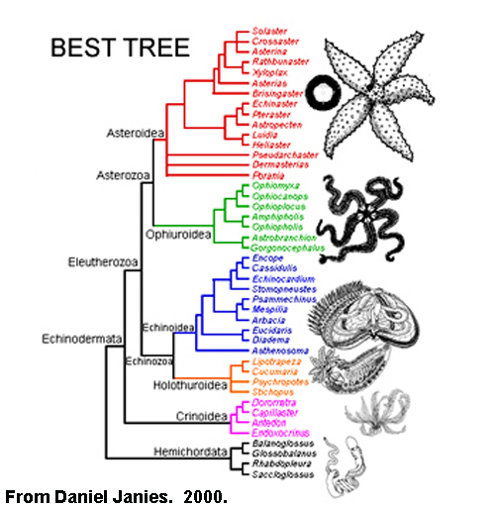
Linnaean Ontology

Slide 5
Classification in the Gene Ontology
a controlled vocabulary for annotations of genes and gene products

Slide 6
GO has three ontologies
molecular functions
biological processes
cellular components

Slide 7
1372 component terms
7271 function terms
8069 process terms

Slide 8
GO astonishingly influential
used by all major species genome projects
used by all major pharmacological research groups
used by all major bioinformatics research groups

Slide 9
GO used to annotate
protein databases
protein interaction databases
enzyme databases
pathway databases
small molecule databases
genome databases
etc.

Slide 10
Each of GO’s ontologies
is organized in a graph-theoretical structure involving two sorts of links or edges:
is-a (= is a subtype of )
(copulation is-a biological process)
part-of
(cell wall part-of cell)

Slide 11
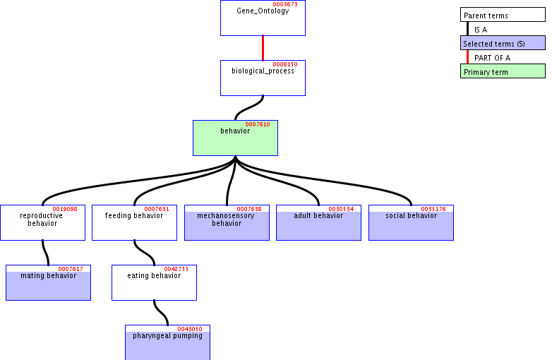
is-a hierarchies in the Gene Ontology

Slide 14
cars
Cadillacs blue cars
blue Cadillacs

Slide 15
Why does multiple inheritance arise?
Because of a limited repertoire of ontological relations
There are only two edges in GO’s graphs
is_a
part_of

Slide 16
GO has only two kinds of sentences
No way to express ‘it is not the case that’
No way to express ‘we do not know whether’
To solve this problem of expressive inadequacy GO invents new biological pseudo-classes

Slide 17
GO:0008372 cellular component unknown cellular component unknown is-a cellular component unlocalized is-a cellular component
Holliday junction helicase complex is-a unlocalized

Slide 18
GO’s excuse
‘unlocalized’ is used as a placeholder only
but automatic information retrieval systems cannot distinguish it from other, genuine class names
what we need is formal tools which can deal with the addition of knowledge into a classification system without the need to create fake classes

Slide 19
Rule of Thumb:
Class names should be positive. Logical complements of classes are not themselves classes.
Terms such as
‘non-mammal’
‘invertebrate’
‘non-A, non-B, non-C, non-D, non-E hepatitis’
do not designate natural kinds.

Slide 20
Problems with multiple inheritance
B C
is-a₁ is-a₂
A
‘is-a’ no longer univocal

Slide 21
GO’s ‘is-a’ is pressed into service to mean a variety of different things
rules for correct coding difficult to communicate to human curators
they also serve as obstacles to integration with neighboring ontologies

Slide 22
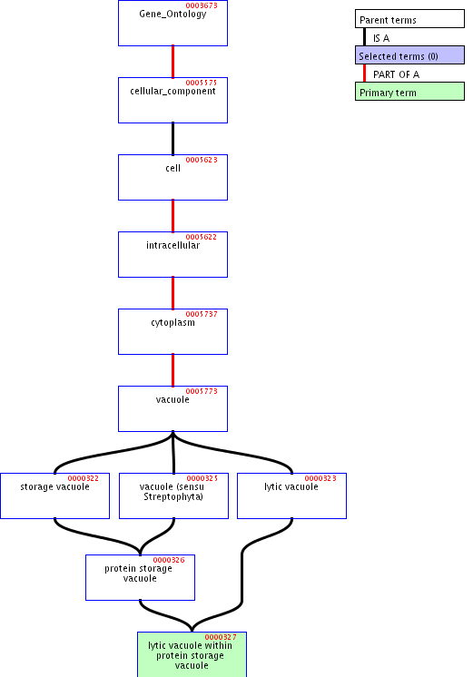

Slide 23
Another term-forming operator
lytic vacuole within a protein storage vacuole
lytic vacuole within a protein storage vacuole is-a protein storage vacuole
embryo within a uterus is-a uterus

Slide 25
Problems with Location
is-located-at / is-located-in and similar relations need to be expressed in GO via some combination of ‘is-a’ and ‘part-of’
… is-a unlocalized
... is-a site of ...
… within …
… in …

Slide 26
Problems with location
extrinsic to membrane part-of membrane
extrinsic to plasma membrane part-of plasma membrane
extrinsic to vacuolar membrane part-of vacuolar membrane

Slide 27
Differentiation and Development
development cellular process
cell differentiation

Slide 28
cell differentiation is-a development
but:
hemocyte differentiation hemocyte development
part-of

Slide 29
Normalization as one solution to the problem of multiple inheritance
Description Logics are formalisms for implementing rigorous domain ontologies
used in projects such as GALEN, GONG, SNOMED-CT

Slide 30
DL’s reasoning facilities
allow us to discover inconsistencies in ontologies automatically
(but: most DLs have problems when handling very large ontologies)
(and they do not find all problems)

Slide 31
Alan Rector’s idea
use DL reasoning facilities to develop ontologies in modular fashion
changes in one module propagated through the system automatically

Slide 32
For this to work
domain ontologies must be normalized
Each module must satisfy the principle of single inheritance

Slide 33
Example:
anatomy module
physiology module
disease module
no is-a relations linking modules
each module a true classificatory tree

Slide 34
cf. GO’s three ontologies
molecular functions
biological processes
cellular components

Slide 35
The modules must be linked by formal relations between their constituent classes
hasLocation
hasParticipant
hasAttribute
etc.
pneumonia is an inflammation which hasLocation lung

Slide 36
The DL classifier
can then compute the subsumption hierarchy which results when the modules are combined. Often the resulting hierarchy is not a tree

Slide 37
But what shall serve as norm for our normalization?
We need a robust top-level ontology containing
(i) an intuitive suite of trees that form its skeleton / basis
and
(ii) an appropriate set of binary relations

Slide 38
Proposal
BFO (Basic Formal Ontology
Proved in practice in error-checking and quality control of large biomedical ontologies

Slide 39
Proposal
BFO (Basic Formal Ontology
+ DOLCE (Laboratory for Applied Ontology, Trento/Rome)

Slide 40
Top-level categories
continuants / endurants / things
vs
occurrents / perdurants / processes.
Continuants are wholly present at any time at which they exist.
Occurrents occur; they unfold themselves phase by phase through time

Slide 41
You vs. Your Life
you are wholly present in the moment you are reading this. No part of you is missing.
your life unfolds itself through its successive temporal parts

Slide 42
Formal Relations
isDependentOn
hasParticipant
hasAgent
isFunctioningOf
isLocatedAt

Slide 43
BFO allows
  automatic filters for ontology authoring
block ontological confusions at the point of data entry

Slide 44
Open Biological Ontologies Consortium
http://obo.sourceforge.net/
Gene Ontology plus: Cell Ontology, Sequence Ontology, Foundational Model of Anatomy, etc.

Slide 45
Open Biological Ontologies Consortium
European Bioinformatics Institute, Cambridge
Jackson Labs, Bar Harbor, Maine
Berkeley Genetics
Edinburgh Mouse Genome Project
Foundational Model of Anatomy, Seattle
IFOMIS, Saarbrücken

Slide 46
OBO Relations Ontology
http://ontology.buffalo.edu/bio
OBORelations.doc

